Slide 1


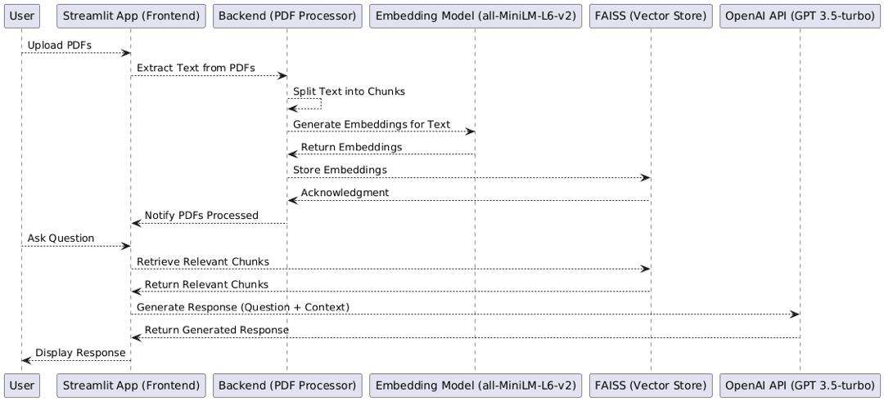
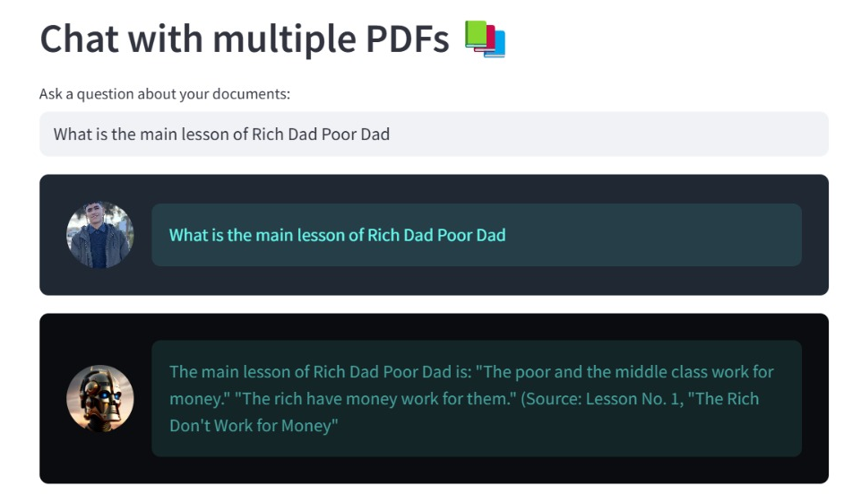
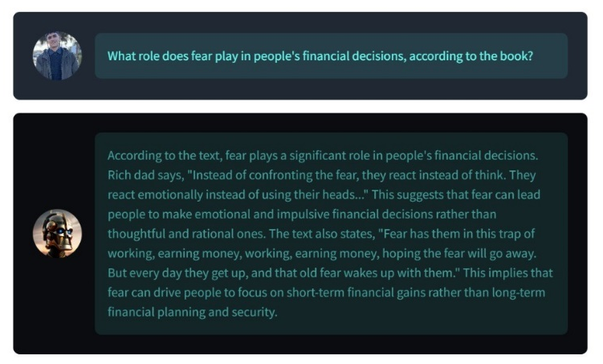
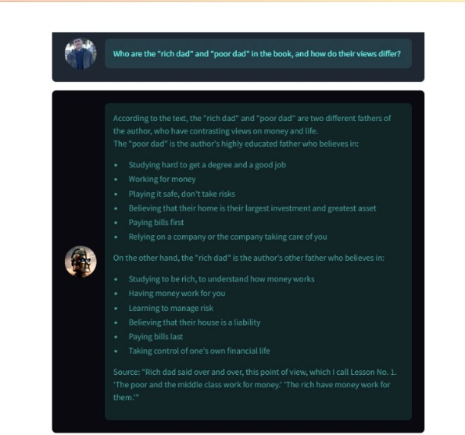
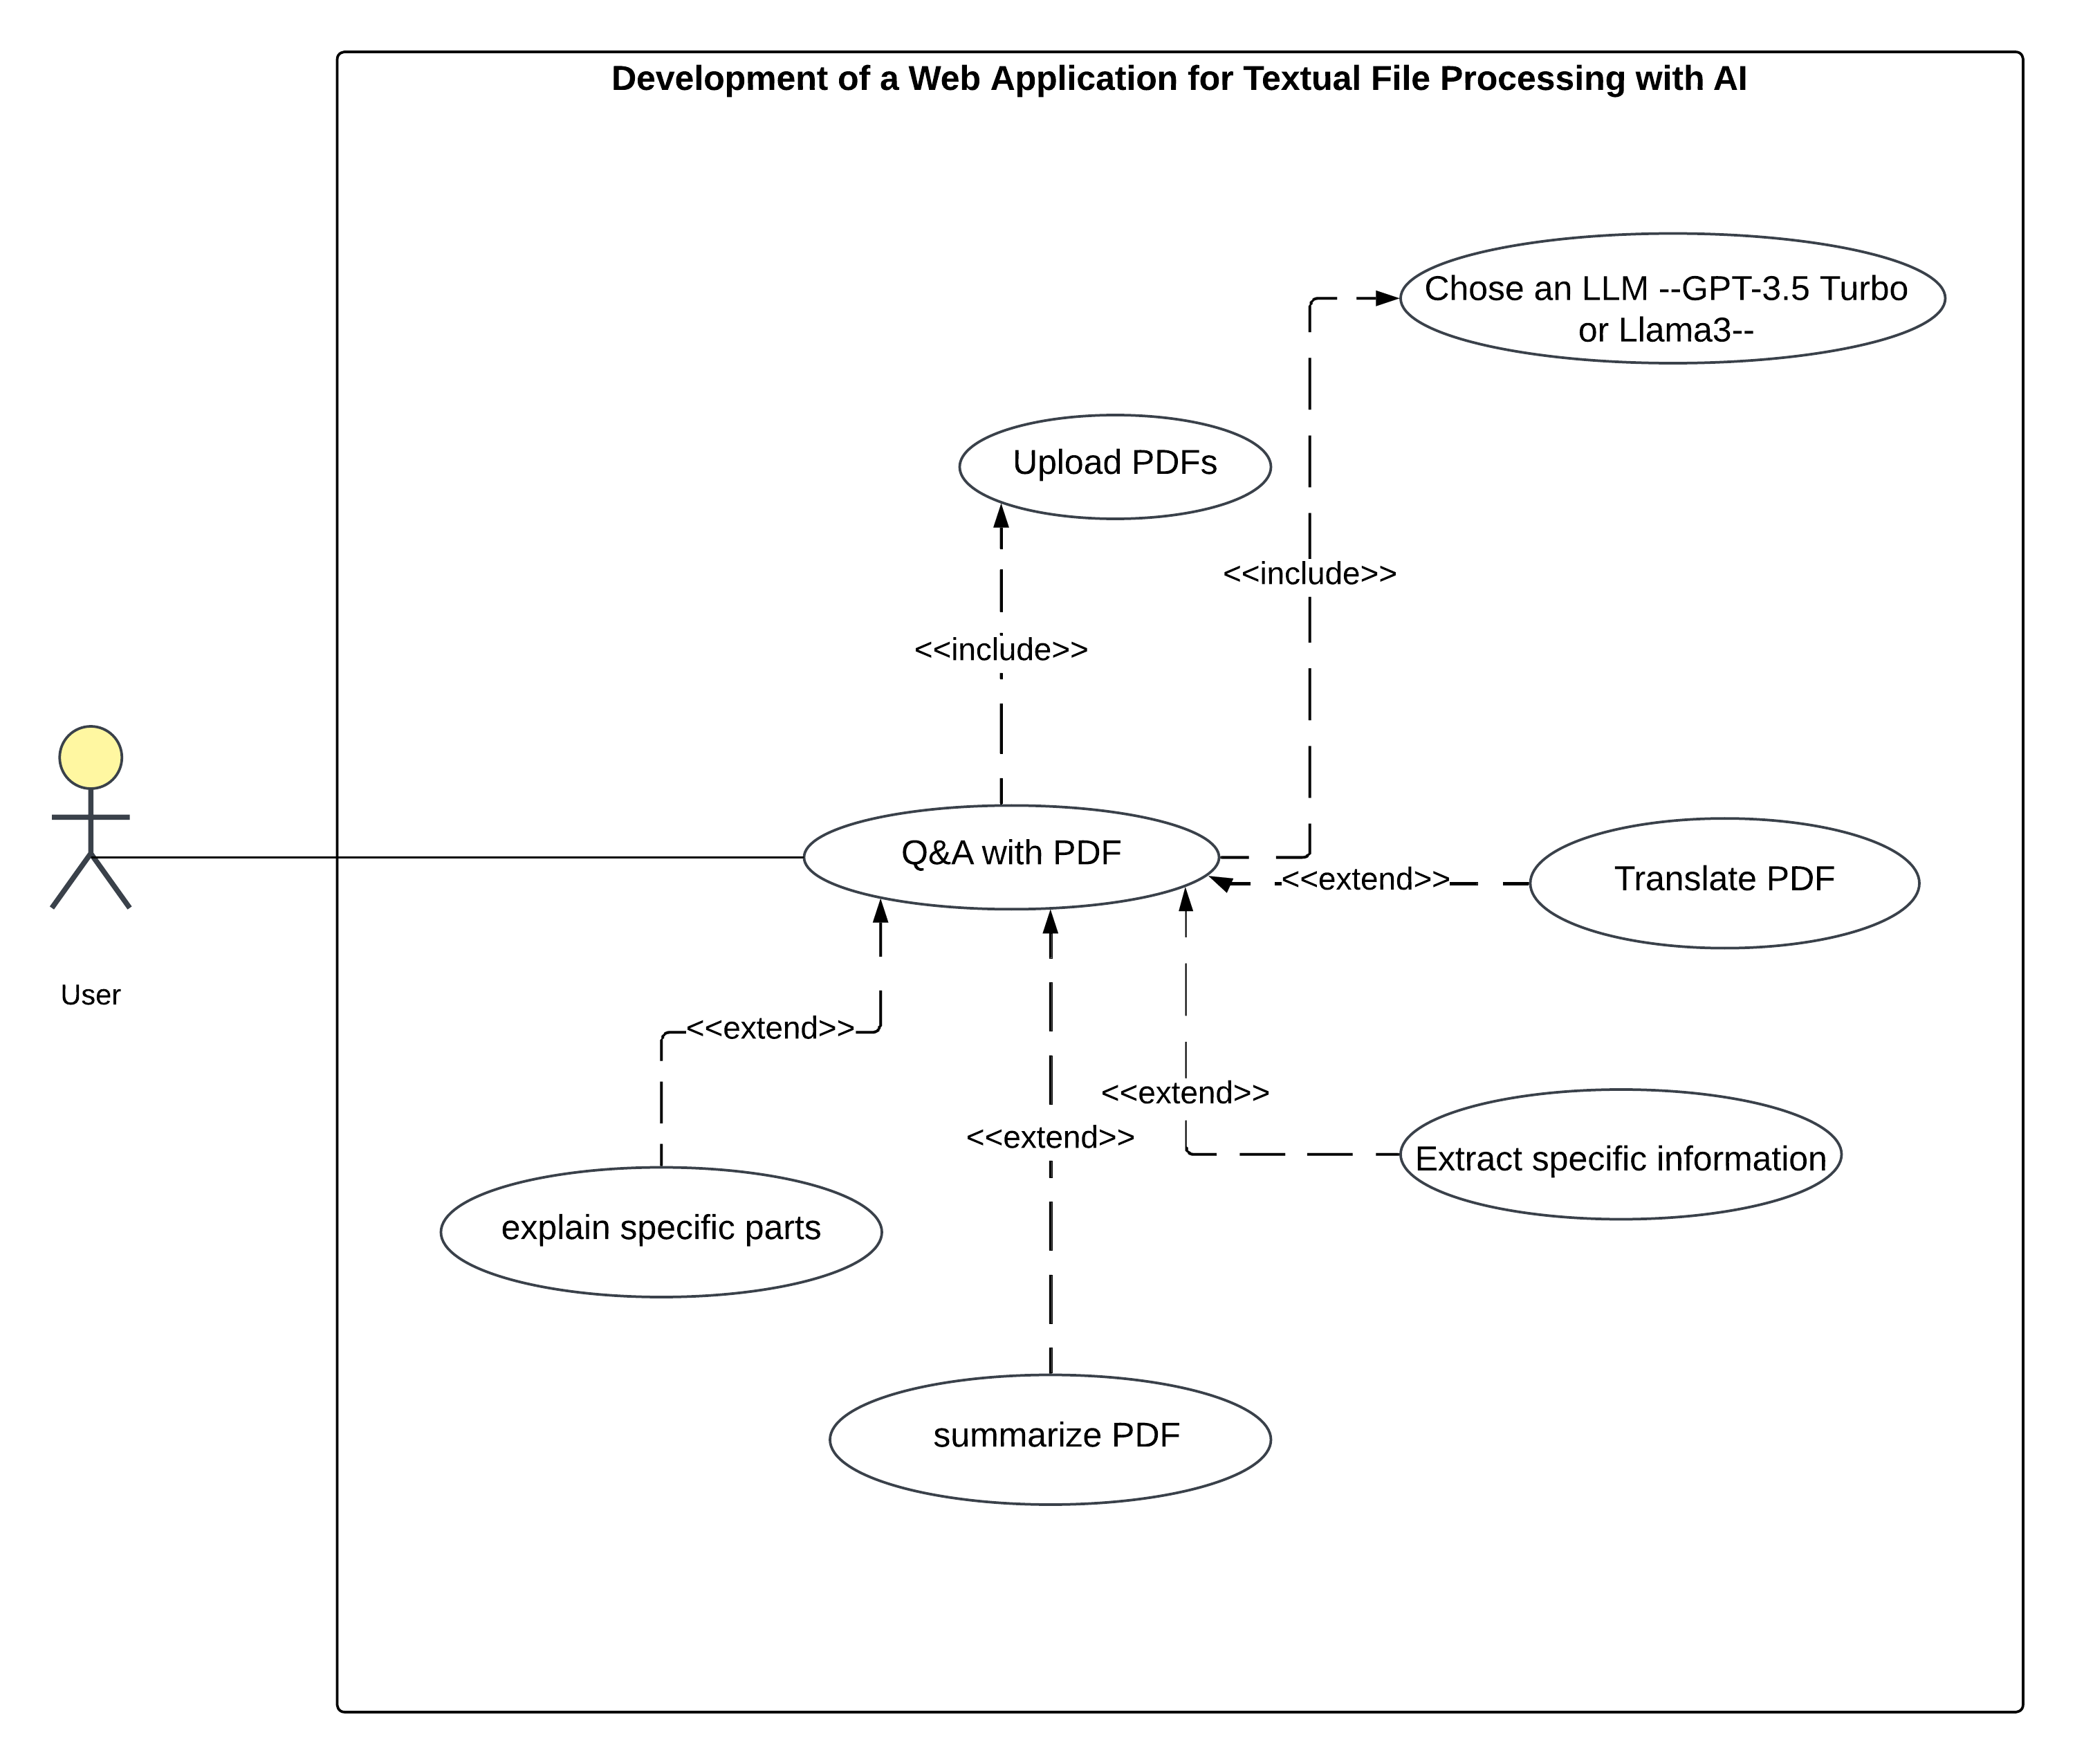
Tahri Mohamed University – Béchar
Faculty of Exact Sciences
Department of Mathematics and Computer Science
Final year project submitted for the award of the Bachelor's degree
Development of a Web Application for Textual File Processing with AI
Presented by: Gasba Ahmed & Ouahabi Abdessamed, Supervised by: Dr. Khair Y
ABSTRACT
In this project, we implemented an AI-powered chatbot system designed to enhance user interaction with PDF documents. This allows for users to upload PDF files, extract, and process text while responding intelligently to questions include dynamic summarization and context-dependent question answering comprise the other core functionalities and are implemented with Hugging Face transformers, FAISS vector similarity search, and large language models, including LLaMA 3.70B and GPT-3.5-Turbo. The system was built using Python and Streamlit and offers a user-friendly interface with functionality for uploading multiple documents.
Figure 2 Sequence diagram
We built our web based chatbot using several modern frameworks and AI models:
Python was used as the core programming language due to its strong support for NLP and AI libraries [1].
LangChain manages the flow between the user’s question, the PDF content, and the language model, allowing for contextual understanding and memory [2].
Streamlit was used to create an intuitive and interactive web interface where users can upload PDF files and chat with the system [3].
Large Language Models (LLMs) such as GPT-3.5 Turbo and Llama 3 process the content and generate accurate responses [4].
INTRODUCTION
In recent years, PDF files have been widely used, in various fields, and sometimes some PDFs contains large amount of data, and maybe this data is out dated or out of the context about what the researcher is searching about. Reading the entire PDF can be time consuming and inefficient, or using keyword searching also become useless in term of context of the PDF. To address this issue, we come up with a web based chatbot that lets users asks questions about the PDF in natural language just like communicating with a friend. Using advances in Natural Language Processing (NLP) and Large Language Models (LLMs) like GPT-3.5 Turbo and Llama 3, the system can summarize content, extract relevant information, and provide accurate answers to user queries. This solution makes it easier to access information, saves time on reading things manually, and shows how helpful conversational AI can be for handling documents.
RESULTS
Technologies and System Architecture
Figure 3 Example 01
Figure 4 Example 02
To further clarify the architecture and functionality of our web-based PDF chatbot, we present the following UML diagrams:
These figures shows an example where the chatbot successfully answered all of the user’s queries about the uploaded book. That was the popular book Rich Dad Poor Dad, which contains over 200 pages. The chatbot was able to extract relevant information and provide accurate, natural language responses.
Before the user star a conversation, he must upload his PDFs (minimum 1 PDF).
The GPT LLM will be as default, and he can change the LLM.
Then the user can ask his questions about the PDF and the chatbot will provide sufficient answers.
Figure 5 Example 03
CONCLUSION
By combining Python, Streamlit, LangChain, Hagging face, and powerful LLMs like GPT-3.5 Turbo and Llama 3 we were able to build this project that demonstrates the power of conversational AI in making PDF document navigation more intelligent and efficient.
Figure 1 Use case diagram
The process begins when the user uploads a PDF through the Streamlit app (frontend) fig 2, which is sent to the backend for text extraction. The extracted content is then split into chunks and passed to an embedding model (all-MiniLM-L6-v2) to generate semantic vector representations. These embeddings are stored in a FAISS vector store for efficient retrieval. Once processing is complete, the user is notified. When the user asks a question, the backend retrieves the most relevant chunks from the vector store and forwards the question and context to the OpenAI GPT-3.5-turbo API.
REFERENCES
[1]: “What’s New In Python 3.13”, Python, https://docs.python.org/3/whatsnew/3.13.html , (Consulted May 12, 2025).
[2]: “Introduction”, LangChain, https://python.langchain.com/docs/introduction/ , (Consulted April 21, 2025).
[3]: “A faster way to build and share data apps”, streamlit, https://streamlit.io/ , (Consulted May 12, 2025).
[4]: Daniel J & all “Martin, Speech and Language Processing”, 3rd edition, Online manuscript released January 12, 2025.
Academic Year 2024/2025

